Slide 1

Information Security
Group Members:
M Aleem Siddique
Abdul Basit
Ahmad Raza

Slide 2

Selected attribute
Confidentiality: Confidentiality is ensuring that there is no unauthorised access to the information
Motivation: Ensuring that the data that is being sent is not viewed by any unauthorised entity is one of the key requirements of cybersecurity and information security.

Slide 3
OUR MECHANISM
Steganography: Use of steganography to ensure confidentiality of the data being sent.
A random integer n: We generate a random integer n and then use that integer in a pre determined formula for steganography.
AES: The message that is to be is encrypted with AES encryption with 128 bit key
Symmetric Cryptography: Prior knowledge about location of n and formula by the receiver

Slide 4
Our mechanism
The random integer n: We generate a random integer n between 2 and 9 and put into the first 8 bytes of the image meaning in the first and second pixels entirely and 2/3rd of the third pixel.
The cipher: The message to be sent is put into the image staring from the 8th byte and then incrementing by the jumps of n
The key: The key used in AES encryption is also put into the image to be sent to the receiver for decryption. The key is put into 9th pixel and then by the jumps of n we proceed.
Receiver: The receiver knows where to find n and the formulas to find the key and the cipher.

Slide 5
Size Considerations
The random n we generate ranges between 2 and 9. In the worst case scenario we will have n = 9 and hence jumps of 9. Total number of bytes in our image are 400x400x3 = 480,000. First eight bytes are used by n so 480,000-8 = 479,992 bytes left. With jumps of we can have 479,992/9 ~ 53,332 bytes. And since one character is equal to 8 bits and in steganography we use LSB of each byte hence we can send a maximum of 53,332 characters.

Slide 6
Implementation
Sender
Receiver
Attack

Slide 7
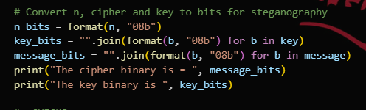
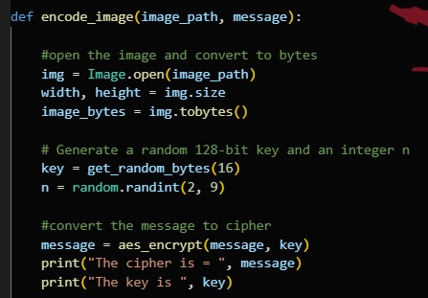
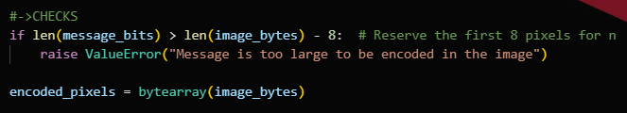
Sender
Opening image, conversion to byte, generate n and the key:
Conversion to bits:
Checks and new image array:

Slide 8
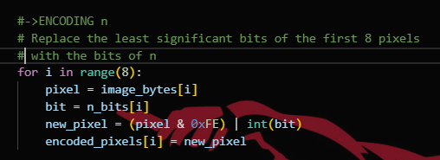
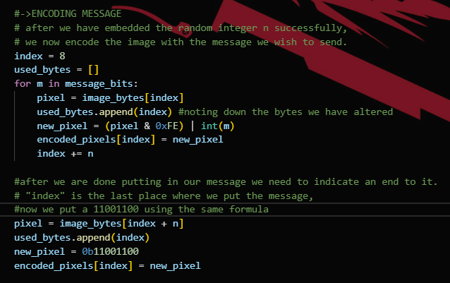
Sender
Encoding n into the image:
Encoding the message into the image:

Slide 9
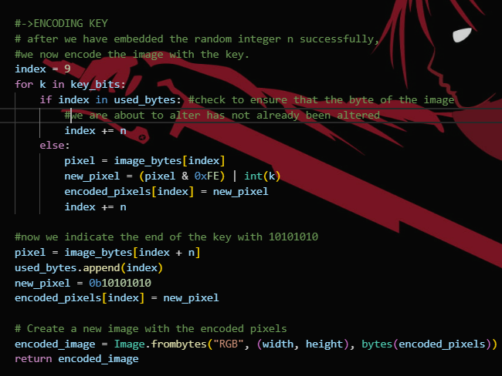
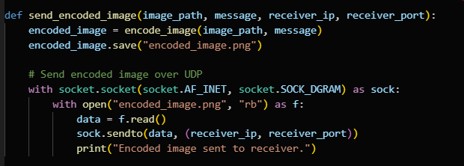
Sender
Encoding key into the image:
Sending the image:

Slide 10
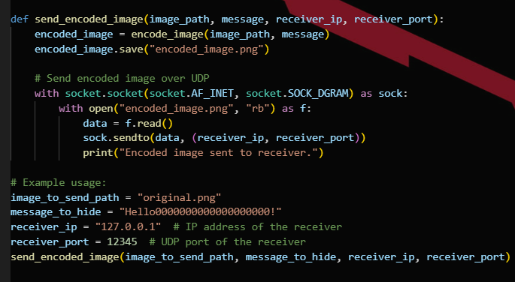
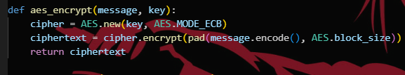
Sender
Sending:
AES:

Slide 11
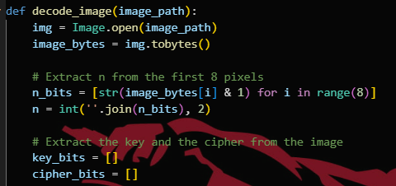
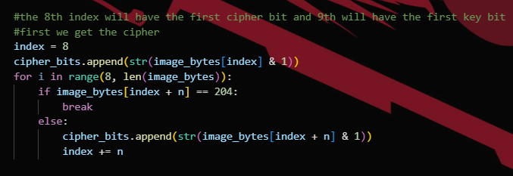
Receiver
After receiving the image, we get to decoding it. We extract n first:
We now extract the cipher:

Slide 12
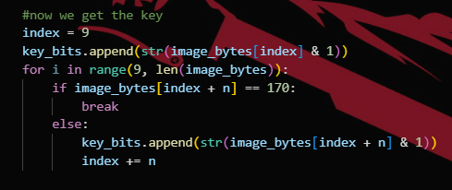
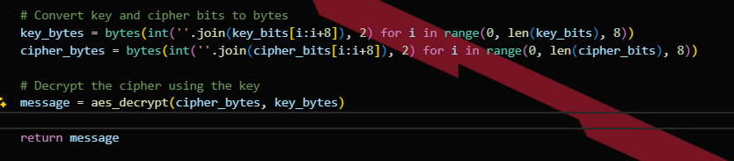
Receiver
Extracting the key:
Conversion to bits and cipher decryption

Slide 13
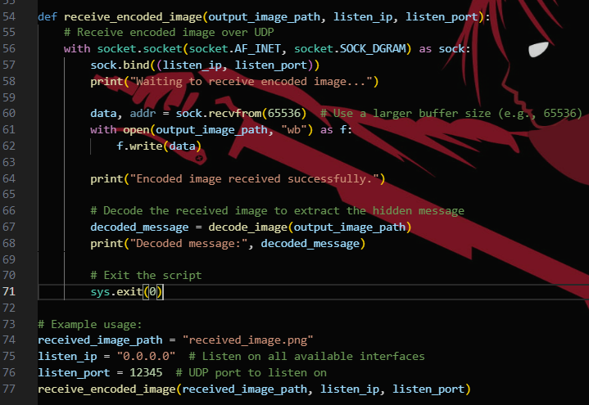

Receiver
Receiving:
AES:

Slide 14
Provision of confidentiality
We need to ensure confidentiality of the message.
The message is encrypted into an AES cipher
The location of the cipher is determined by an already set formula
The formula needs n, a randomly generated integer
The location of n within image is also already set
The AES decryption key is randomly generated and its location determined by n as well.

Slide 15

Attack
A brute force attack will have huge difficulty to break the method because:
Need to know if there is some n embedded in the image. Need to know what and where is n Need to know the formula to get the key and the cipher Need to know the encryption algorithm Need to know the stopping criteria

Slide 16
Assumptions
We assume that the attacker knows the AES encryption.
We also assume that the attacker has somehow intercepted the channel and got the encoded image.
He somehow that there is n embedded in the start of the image.
He also knows the stopping bits of the cipher and the key.
He also know that the key length is 128 bits of AES encryption

Slide 17
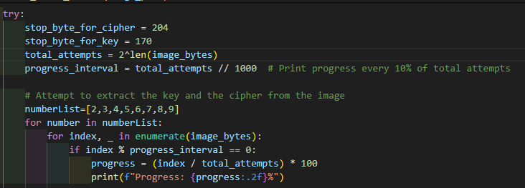
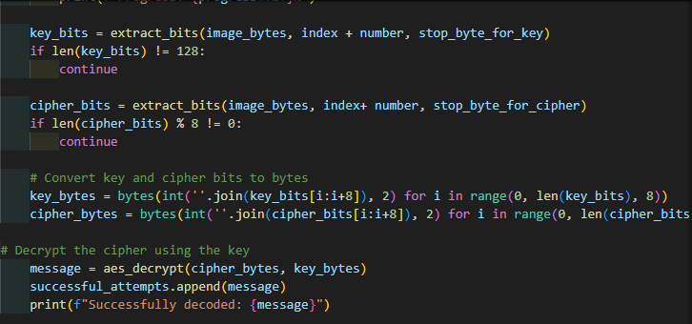
He got the image, extracted the bits out of it and will try to find the combination of each bit of the image with each number i.e, from 2 to 9.
He will iterate over the image and tries to add the number to the index of image to find the key and cipher bits and will decrypt through AES decryption

Slide 18
Recommendations
The random integer n should be embedded in a less obvious way.
The embedding formula should be complicated.
The method should be evolved to handle video steganography.
Since the method falls under the category of symmetric cryptography, there should be a secure way of sharing the embedding formula and the location of n

Slide 19
Contributions
M Aleem Siddique – Sender Code
Abdul Basir – Attack Simulation
Ahmad Raza – Receiver Code
REFERENCES: Usage of already implemented AES algorithm from pycyptodome python library.

